Slide 1
Section 4
Mole Fraction

Slide 2
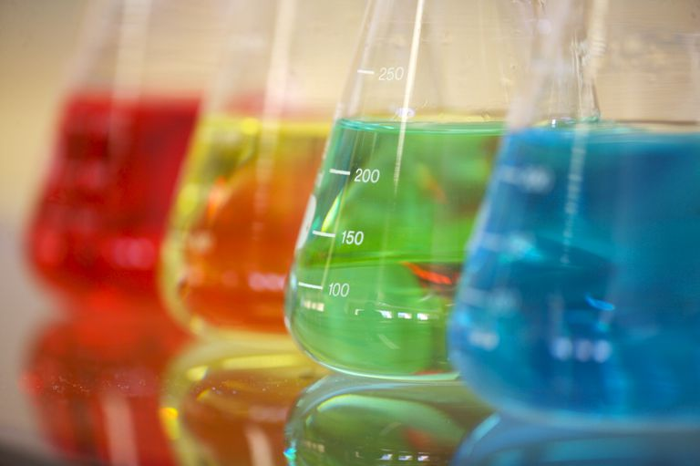
Review
Concentration is how much solute is present a certain amount of solvent or solution
So far we studied molarity and molality

Slide 3
Mole Fraction
A mole fraction, X, is the ratio of moles of a solute to the total moles in the solution

Slide 4
When Given Grams
Convert everything from grams to moles using Periodic Table
Put only the moles of solute on top
Add together moles of EVERYTHING for the bottom
Then use the formula to solve for the mole fraction

Slide 5
Example
A 11.00 g sugar cube (sucrose: C₁₂H₂₂O₁₁) is dissolved in a 12.5 g of water. What is the molality of the solution?
Step 1: Convert all grams to mols
= 0.0322 mol
= 0.694 mol
1 mol
11.00 g C₁₂H₂₂O₁₁ =
342 g
1 mol
12.5 g H₂O =
18.02 g

Slide 6
Step 2: Add all mole together
0.0322 mol + 0.694 mol = 0.726
Step 3: Use formula and solve for X
0.0322 mol
= 0.0444
0.726 mol

Slide 7
Practice
Worksheet

